Slide 1
Structural causal model for leveraging observational data (EHR, Device data) complementary to randomized controlled trial(RCT)
Yonghan Jung^{1,3}
Mohammad Adibuzzaman³
Yuehwern Yih^{1,3}
Elias Bareinboim⁴
Marvi Bikak²
¹School of Industrial Engineering, Purdue University, West Lafayette, USA
²Indiana University School of Medicine, Indianapolis, USA ³Regenstreif Center for Healthcare Engineering, Purdue University, West Lafayette, USA
⁴Department of Computer Science, Purdue University, West Lafayette, USA

Slide 2
Randomized controlled trial: gold standard for evidence based medicine
1962 Drug Amendments Law for FDA
“All drugs should be approved on the basis of well-controlled experimental study”.
RCT became a gold standard for clinical trial
Why?
Causal inference by
Removing confounding bias and selection bias.
Notes:
“adaptation” instead of enforced.

Slide 3
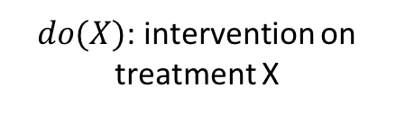
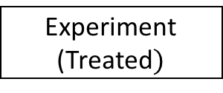
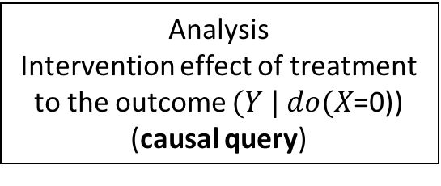
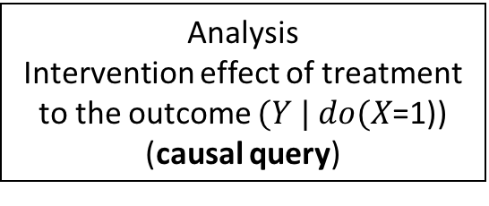
randomized control trial
effect of treatment /drug on outcome?”
To remove confounding bias
Demographic (age / sex / race)
Physiological (heart rate, etc.)
Sociological (income)
Etc.
Randomizing patients (coin tossing!)
Experiment
(Treated$)$
Control
(Non-treated)
$do(X)$: intervention on treatment X
Analysis
Intervention effect of treatment to the outcome $(Y | do(X$=1)) (causal query)
Analysis
Intervention effect of treatment to the outcome $(Y | do(X$=0)) (causal query)

Slide 4
Limitations of randomized controlled trial
Ethical/safety issues
Target patients are pregnant woman
Smoking / Non-smoking?
Limited samples
Limited number of patients.
Sampling selection bias
Cost
Time
Money

Slide 5
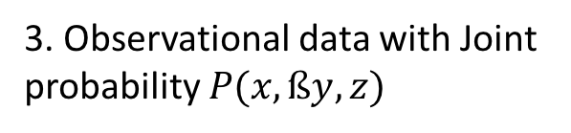
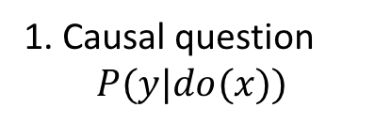
Alternative to rct: observational data
Question: Is it possible to conduct virtual experimental study by using 1) clinical knowledge and 2) observational data?
1. Causal question
$$P(y|do(x))$$
Challenge
1. How to derive structure (model) from observational data?
2. Model based on clinical knowledge
Z
Confounders
2. How to answer causal question given structure from observational data without confounding bias?
Treatment
X
Y
Outcome
3. Observational data with Joint probability $P(x,ßy,z)$

Slide 6
explore SCM to answer the causal question
Explore Structural Causal Model (SCM) to answer the causal question with attenuating the challenges.
Why?
Graphical encoding of clinical knowledge (transparency and flexibility)
Algorithmically derivation of formula (Causal diagram in, Formula out)

Slide 7
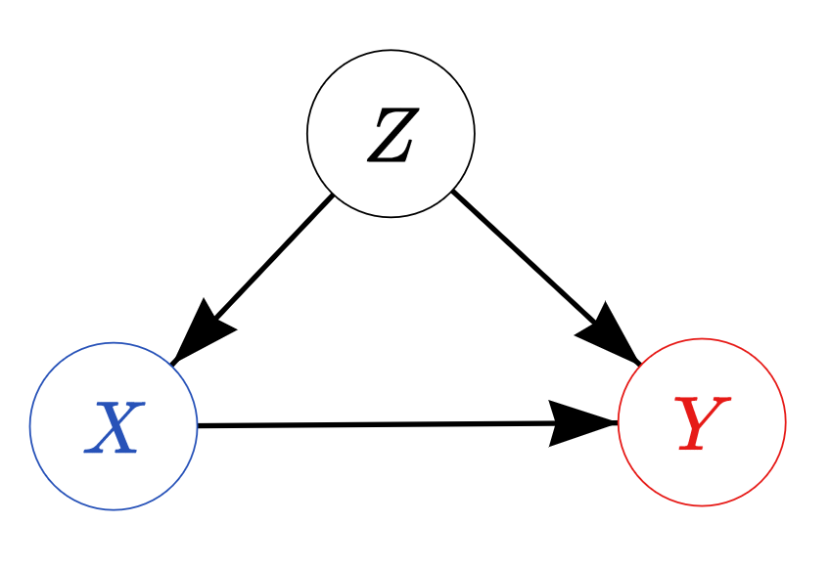
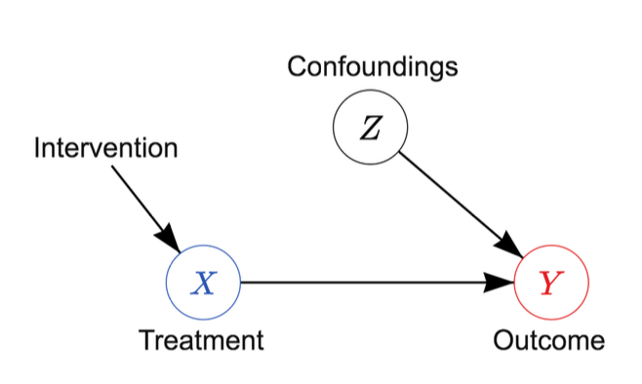
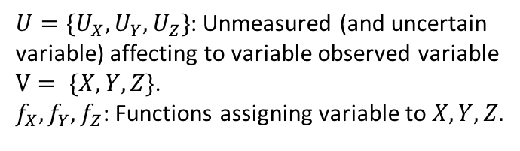
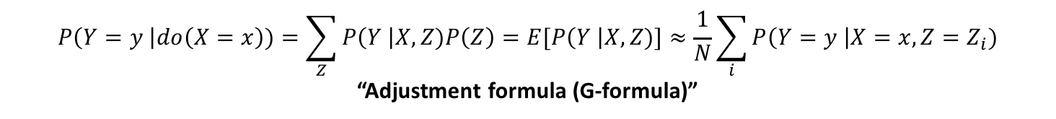
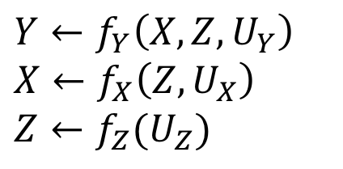

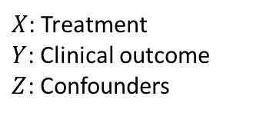
Definition of SCM : <G, F, V, U>
Causal diagram (Structures)
Specifying relationship between variables.
Structural equations
A model about the relationship.
$X$: Treatment
$Y$: Clinical outcome
$Z$: Confounders
$$Y←f_{Y}\left(X,Z,U_{Y}\right)$$
$$X←f_{X}\left(Z,U_{X}\right)$$
$$Z←f_{Z}(U_{Z})$$
$U=\{U_{X}, U_{Y}, U_{Z}\}$: Unmeasured (and uncertain variable) affecting to variable observed variable $V= \{X,Y,Z\}$.
$f_{X}, f_{Y},f_{Z}$: Functions assigning variable to $X,Y,Z.$
$do(X=x)$ (intervention on treatment)
$$P\left(Y=y \right|do\left(X=x\right))=\sum_{Z}{P\left(Y \right|X,Z)P\left(Z\right)=E[P\left(Y \right|X,Z)]}≈\frac{1}{N}\sum_{i}{P\left(Y=y \right|X=x,Z=Z_{i})}$$
“Adjustment formula (G-formula)”

Slide 8
Summary of our clinical topic
Summary of our clinical topic and notion
Disease: Acute Respiratory Distress Disease (Lung cell out-of-order, so one cannot breathe by him/herself).
Treatment: Mechanical ventilator (a machine for helping one to breathe) setting.
Tidal volume (VT): amount of the air capacity of lung (control CO2 in blood)
Positive End Expiratory Pressure (PEEP) : Default air pressure after exhaling (control O2 in blood)
Plateau pressure (PP): Air pressure when inhaled and holding a breathe.
FiO2: % of oxygen in the air.
Outcome: Mortality rate (28 / 60 / 90 days after the onset).

Slide 9
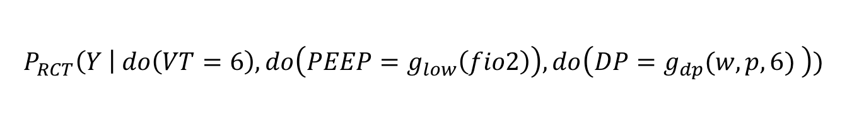
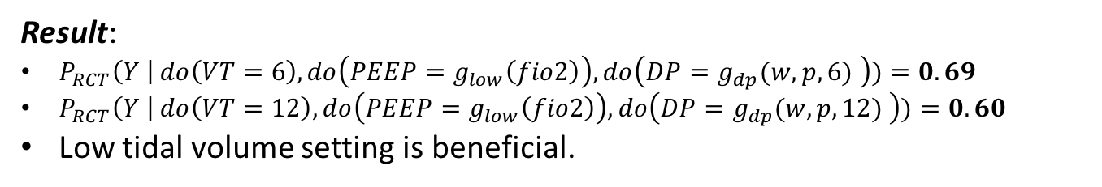
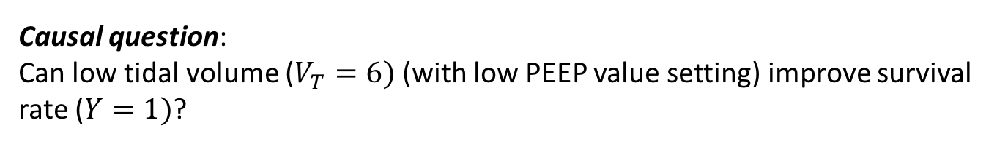
RCT 1: ARMA trial (ARDS Network 2000)
Causal question:
Can low tidal volume ($V_{T}=6)$(with low PEEP value setting) improve survival rate ($Y=1)$?
Other mechanical ventilation setting values fixed same for both group ($PEEP, FiO_{2})$ . $f$ and $w$ is a realization of random variable FiO2 and Weight.
$$P_{RCT}\left(Y \right| do\left(VT=6\right),do\left(PEEP=g_{low}\left(fio2\right)\right),do\left(DP=g_{dp}(w,p,6) \right))$$
Result:
$P_{RCT}\left(Y \right| do\left(VT=6\right),do\left(PEEP=g_{low}\left(fio2\right)\right),do\left(DP=g_{dp}(w,p,6) \right))=0.69$
$P_{RCT}\left(Y \right| do\left(VT=12\right),do\left(PEEP=g_{low}\left(fio2\right)\right),do\left(DP=g_{dp}(w,p,12) \right))=0.60$
Low tidal volume setting is beneficial.

Slide 10
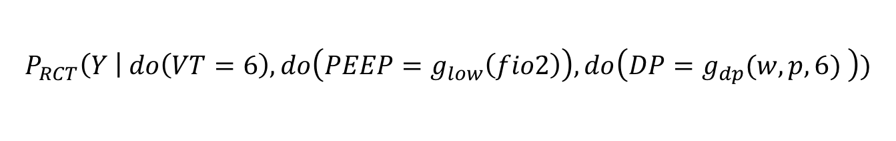
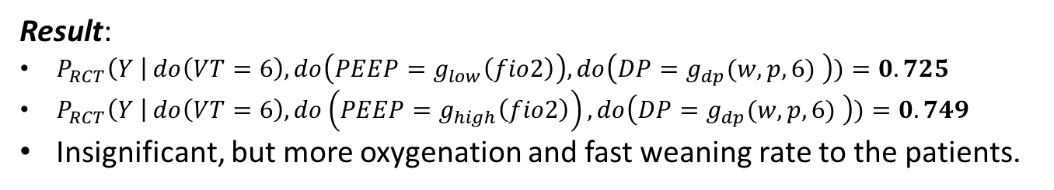
RCT2:ALVEOLI trial (ARDS network 2004)
Causal question:
Can high Positive End Expiratory Pressure (PEEP) value improve survival rate?
Other mechanical ventilation setting values fixed same for both group ($PEEP, FiO_{2})$ . $f$ and $w$ is a realization of random variable FiO2 and Weight.
$$P_{RCT}\left(Y \right| do\left(VT=6\right),do\left(PEEP=g_{low}\left(fio2\right)\right),do\left(DP=g_{dp}(w,p,6) \right))$$
Result:
$P_{RCT}\left(Y \right| do\left(VT=6\right),do\left(PEEP=g_{low}\left(fio2\right)\right),do\left(DP=g_{dp}(w,p,6) \right))=0.725$
$P_{RCT}\left(Y \right| do\left(VT=6\right),do\left(PEEP=g_{high}\left(fio2\right)\right),do\left(DP=g_{dp}(w,p,6) \right))=0.749$
Insignificant, but more oxygenation and fast weaning rate to the patients.

Slide 11
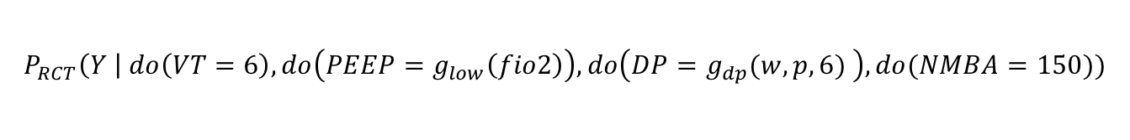
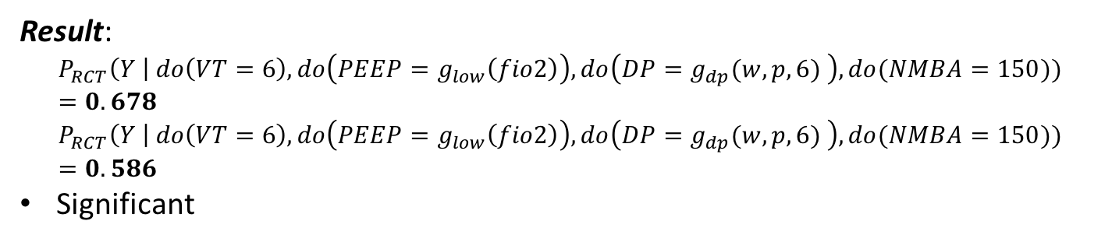
RCT3: ACURASYS trial (Papazian 2010)
Causal question:
Can treatment of NMBA (cisatracurium) treatment improve survival rate to more severe patients?
Other mechanical ventilation setting values fixed same for both group ($PEEP, FiO_{2})$ . $f$ and $w$ is a realization of random variable FiO2 and Weight.
$$P_{RCT}\left(Y \right| do\left(VT=6\right),do\left(PEEP=g_{low}\left(fio2\right)\right),do\left(DP=g_{dp}(w,p,6) \right), do(NMBA=150))$$
Result:
$$P_{RCT}\left(Y \right| do\left(VT=6\right),do\left(PEEP=g_{low}\left(fio2\right)\right),do\left(DP=g_{dp}(w,p,6) \right), do(NMBA=150))=0.678$$
$$P_{RCT}\left(Y \right| do\left(VT=6\right),do\left(PEEP=g_{low}\left(fio2\right)\right),do\left(DP=g_{dp}(w,p,6) \right), do(NMBA=150))=0.586$$
Significant

Slide 12
Experiment design
MIMIC3 – open ICU Electronic Healthcare record
Clinical Database
Waveform Database
Matched
Subset
58,000 Hospital Admission
2001-2012
Nurse entered physiology
Medications
Laboratory data
Nursing notes
Discharge notes
Format: CSV, SQL
~40GB
23,180 Records
2001-2012
Waveforms
ECG
Blood pressure
Plethysmography
Format: Text, Matlab
~3TB Compressed
4,897 Waveform and 5,266 Numeric records matched with 2,809 clinical records

Slide 13
Experiment design – cohort selection
Inclusion criteria
ARDS patients
Mechanical ventilated (MV).
(PaO2: FiO2) <= 300 (Berlin score) at any time Within 48 hours of ICU admission (closest measurement)
A
Include patients Age >= 18
Exclude patients with congestive heart failure by ICD-9 code.
Include If CB is administered after Berlin score is measured or CB is not administered
Inclusion criteria
B
Yes
No
C
Cisatracurium Besylate (CB)
D
Death in 90 days after the last day of CB taken
No
Death within 90 days of the last use of MV?
F
H
Yes
E
G
4050

Slide 14
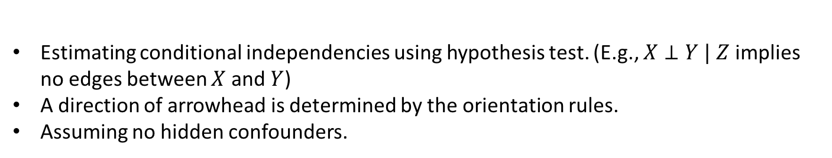
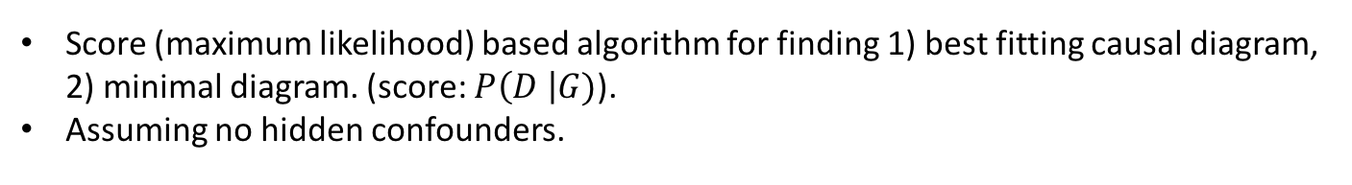
Learning structure (causal diagram)
PC algorithm
Estimating conditional independencies using hypothesis test. (E.g., $X⊥Y | Z$ implies no edges between $X$ and $Y$)
A direction of arrowhead is determined by the orientation rules.
Assuming no hidden confounders.
GES algorithm
Score (maximum likelihood) based algorithm for finding 1) best fitting causal diagram, 2) minimal diagram. (score: $P\left(D \right|G)$).
Assuming no hidden confounders.
FCI algorithm
A modification of the PC algorithm that drops ’no hidden confounders’ assumption.
Edge selection rule
Edges voted by majority of algorithms, without conflicting medical knowledge, were chosen.
Verification by medical experts

Slide 15
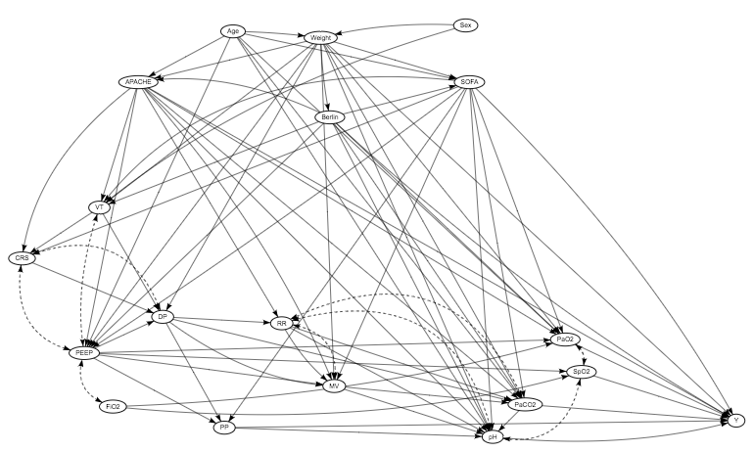
Causal diagram generation

Slide 16
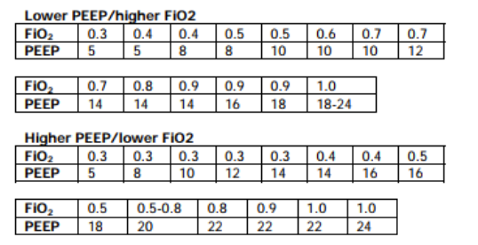
Specification of intervention (ARDS network protocol)
Ventilator setup and adjustment
Compute predicted body weight (PBW) / Mode: volume control
Starting from VT=8ml/PBW ➔ 6ml/PBW.
Adjust to achieve PaO2: 55-80 / SpO2 88-95%, PP <= 30.
Use Minimum PEEP 5.
PIP?

Slide 17
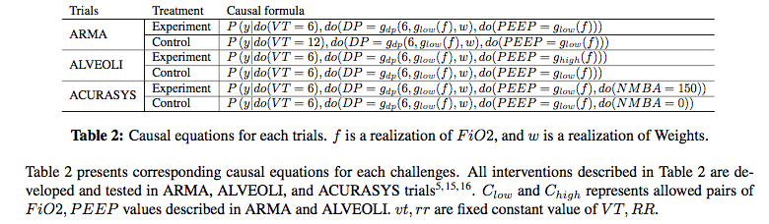
Comparison with RCT

Slide 18
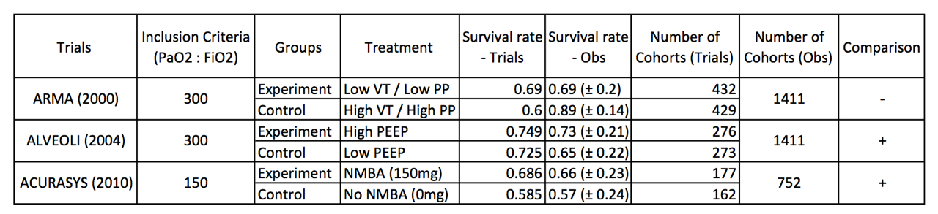
Comparison with RCT - 2

Slide 19
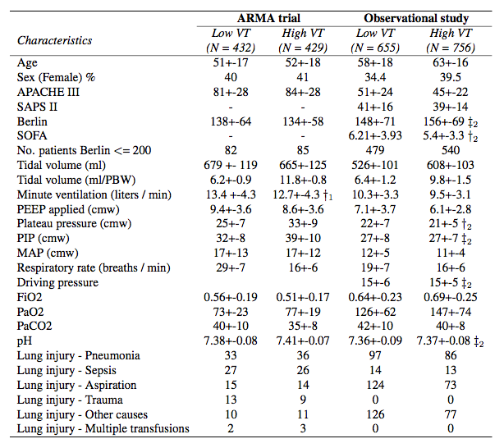
Heterogeneity in baseline characteristics - ARMA

Slide 20
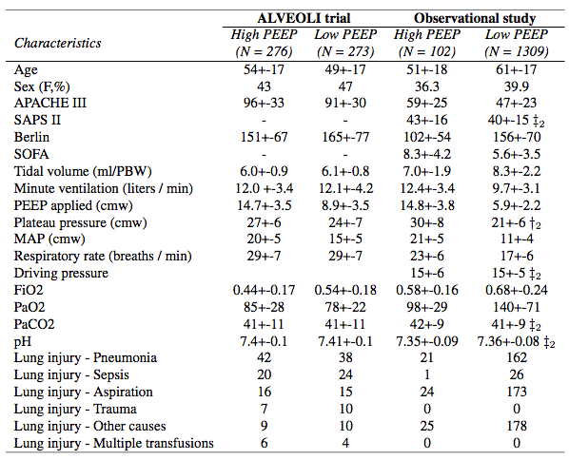
Heterogeneity in baseline characteristics - ALVEOLI

Slide 21
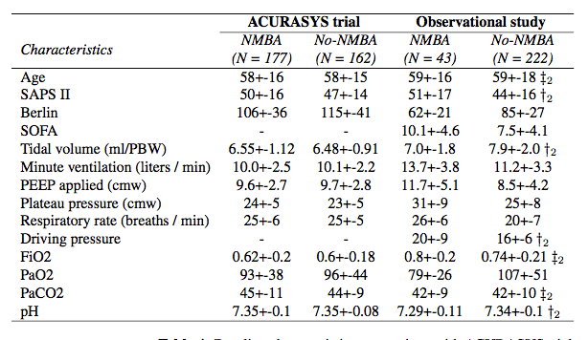
Heterogeneity in baselin characteristics - ACURASYS

Slide 22
Research direction
Summary
Our goal: Develop and demonstrate a systemic procedure to conduct virtual experiment.
Contribution: Introduce SCM to the medical domain, which SCM is not broadly used even if its advantage in explicitly incorporating clinical knowledge and providing broader chance to analyze data.

Slide 23
Research direction
Research direction
1. Personalized ventilation strategy.
2. Treatment – Treatment interaction
3. Sequential treatment allocation

Slide 24
Causal assumption from other literatures
References
Papazian et al., (2010) “Neuromuscular Blockers in Early Acute Respiratory Distress Syndrome,” New England Journal of Medicine
Brower, Roy G., et al. "Higher versus lower positive end-expiratory pressures in patients with the acute respiratory distress syndrome." The New England journal of medicine 351.4 (2004): 327.
Amato, M. B. P., et al. "Ventilation with lower tidal volumes as compared with traditional tidal volumes for acute lung injury." N. Engl. J. Med 343.2000 (2000): 812-814.
Shpitser, I., & Pearl, J. (2006). Identification of joint interventional distributions in recursive semi-Markovian causal models. In Proceedings of the National Conference on Artificial Intelligence (Vol. 21, No. 2, p. 1219). Menlo Park, CA; Cambridge, MA; London; AAAI Press; MIT Press; 1999.

